Slide 1

DSBA 6156 - Group Project
Advanced Handling of Raw Text
Sentiment Analysis and Modelling using Machine Learning Techniques
Group 3:
Alvis Chung, Ganesh Viswanathan, Minglan Ye, Niraj Bista

Slide 2
Agenda
Introduction
Objectives & Implementation Methodology
Dataset
NLP - Sentiment analysis
Implementation
Data Cleaning
Exploratory data analysis
Sentiment Analysis using advanced NLP techniques
Feature importance
Final modelling and predictions
Conclusions and learnings
Accuracy and metrics of final model
Benefits with current approach and model
Notes:
Ask the folks what is the reason they left for the last employment? And what's the common reason why they leave jobs? [might be too long]
I was going to ask if they have experiencing filling out a survey after receiving help from customer service.

Slide 3
Objectives
Goal: Apply Machine learning techniques to Predict Employee Attrition to Improve Employee Retention.
Data Cleansing techniques
Perform NLP techniques to text fields in data set to predict Attrition
Employee Attrition = Turnover Prediction
Pipelines approach to creating models
Recommendations to improve the data and model accuracy

Slide 4
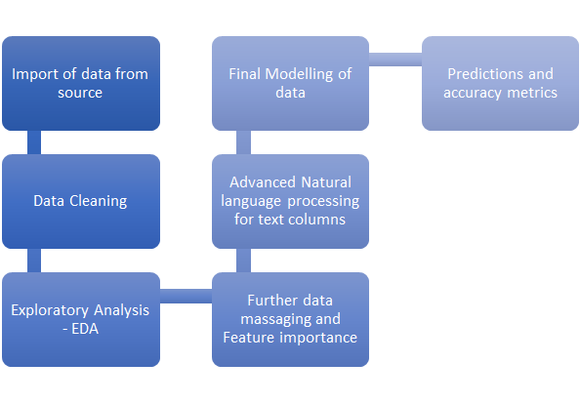
Implementation Methodology

Slide 5
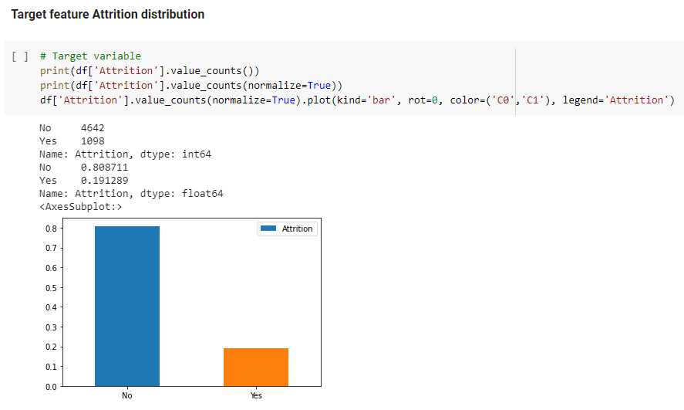
Dataset
Dataset DR_Demo_Employee_Attrition.csv
5740 Rows and 36 Columns
Attrition is chosen to be the dependent variable
Leave(Yes): 1098 which is 19%
Stay(No): 4642 which is 81%
The data set is imbalanced as shown in the figure
The dataset is mostly clean with no missing values
The features easily fit into numerics, categories with just one text field
Notes:
Our dataset is considered unbalanced since more people stay in the organization, takes up 81% of the data.

Slide 6
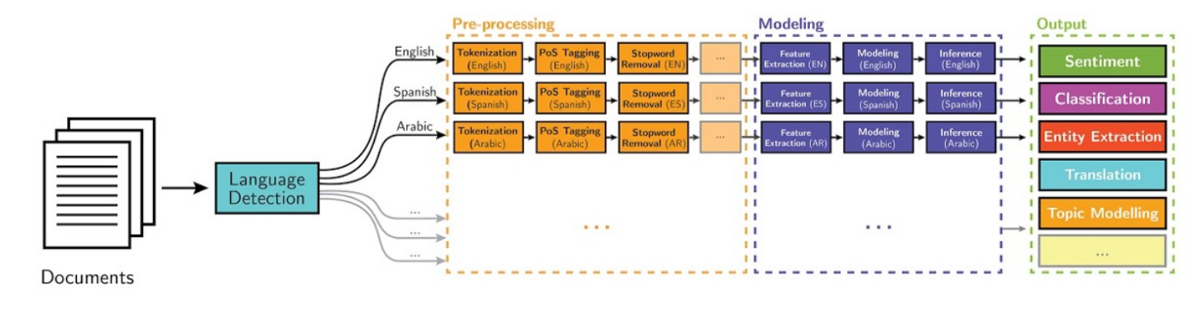
Natural language processing
Branch of artificial intelligence that deals with the interactions between computers and humans using natural language

Slide 7
Natural language processing - Sentiment Analysis
Contextual/Opinion Mining
What is it? Analyzing text message to predict underlying sentiment
Text from? Emails, surveys, social media, ecommerce platforms
Goal?
Identifying news, opinion, suggestion, appreciation and complaints
Approaches - Supervised, Rule based and hybrid approaches
Advantage / Strengths
Monitor brand health, spot crisis early, perform self and competitor analysis
Provides avenue to listen to your customers - informal/watercooler talks are mostly the first indication of a problem
Disadvantage / Weaknesses
Low accuracy as predicting mindset of reviewer is difficult
Humans are not always straightforward - Eg: Sarcasm, negations

Slide 8
Data Cleaning
Missing Values
No missing values in the sample dataset
Inconsistencies
No inconsistencies values in columns
Below columns has only 1 value
Over 18
Employee Count
Outliers
No outliers values found
Encoding of Categorical Features
Used one hot encoding and ordinal encoding to code categorical features
Performance Review Text Cleaning
Change to strings for all the reviews and lowercase
Remove stop words (nltk.corpus - stopwords)
Remove punctuations (string - punctuation)
Stemming and Lemmatizer
Find the root of the words

Slide 9
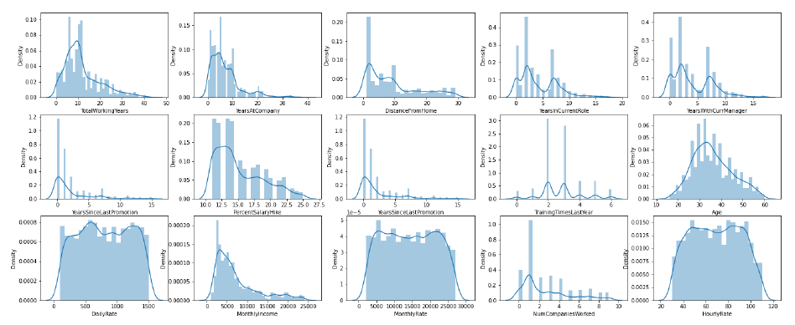
Exploratory Data analysis - EDA
Notes:
Continuous features distribution - some of the features are high skewed and some follows normal distributions.
Few things want to point out in the distribution chart here. We can see that people normally get promoted within the 5 years.
Age distribution is well spread with maximum number of employees around 25 to 50 years old
Salary hike distribution is left skewed with 15% to 25% being the maximum occured.
Hourly rate is from 40 to 100$.

Slide 10
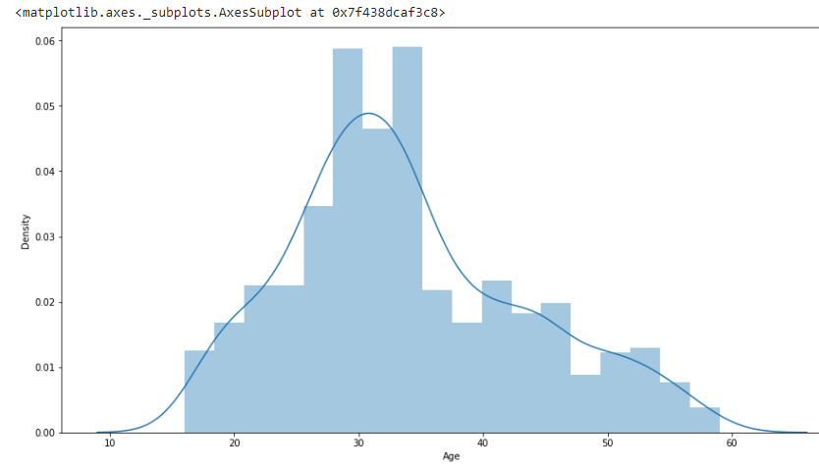
Visualizations and Insights
Observations:
Attrition is max between 25 - 35.
Attrition increasing from age 18 to 30
Attrition falling down after 35 to 60.
Notes:
YES - MEANS GONE
Younger folks like to explore the options of life therefore they are from age 18 - 30 is a searching age for them to see what is the best company for them.
After 35 years old, people are more settle down with the job and company.

Slide 11
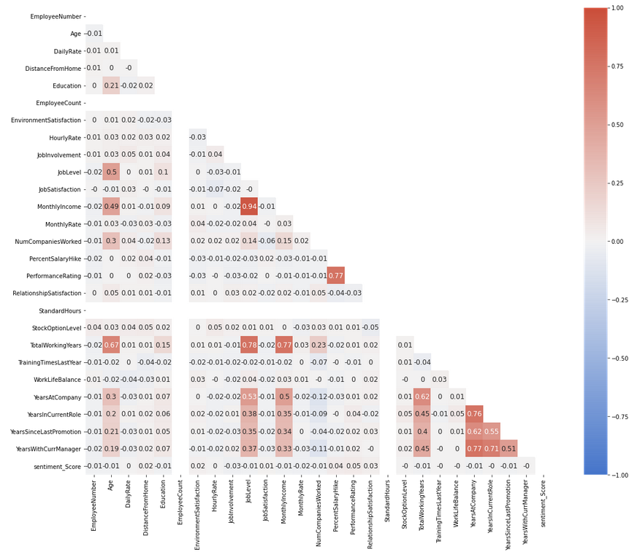
Heat Map to find correlated data and relations
Notes:
Heatmap for correlation between
Based on the heatmap, monthly income has the highest score which is highly correlated. we drop the less significant features.
Example: 'EmployeeNumber', 'YearsInCurrentRole', 'PerformanceRating', 'RelationshipSatisfaction','PercentSalaryHike', 'DailyRate',
'DistanceFromHome', 'Gender', 'MonthlyRate', 'NumCompaniesWorked', 'TrainingTimesLastYear',
'WorkLifeBalance','Over18', 'performance_review'.

Slide 12
Sentiment Analysis using advanced NLP techniques
Extract the Natural language features from the data set along with other relevant columns which can help to predict sentiment
Vectorize the the text into numbers using countVectorizer /TFIDF techniques
Step1
Step3
Step2
Step4
Standardize and normalize spoken english using NLP techniques like tokenizing, removal of stop words, stemming and lemmatization
Finally use a classification model to machine learn the sentiment, model it , select the right model with good metrics and use it for future predictions

Slide 13
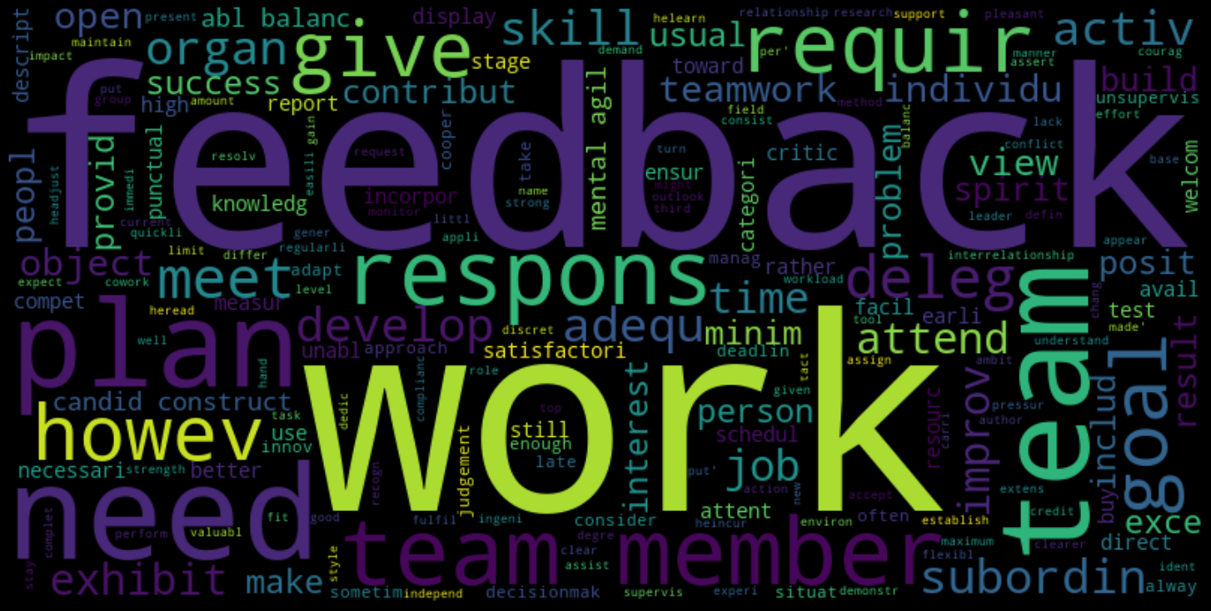
Word cloud for performance review field of attrition data
Notes:
Wordcloud before separating good/bad reviews.
Team, work, response, feedbacks are the common words you can see in the performance review.

Slide 14
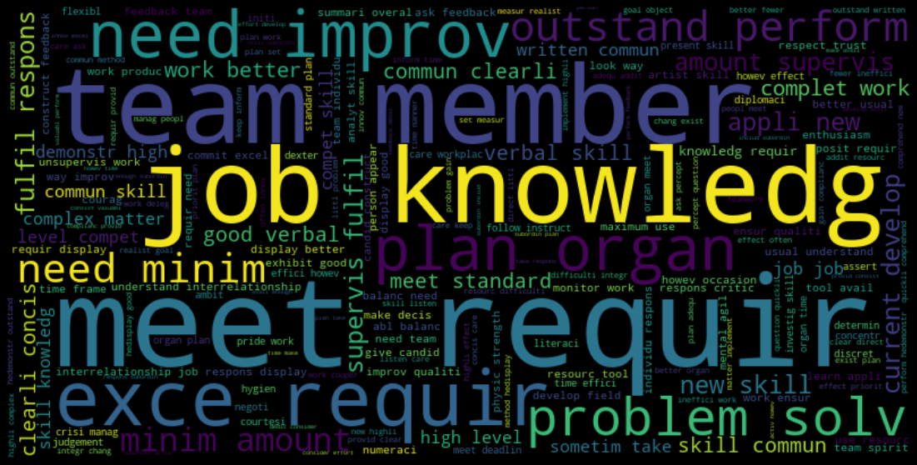
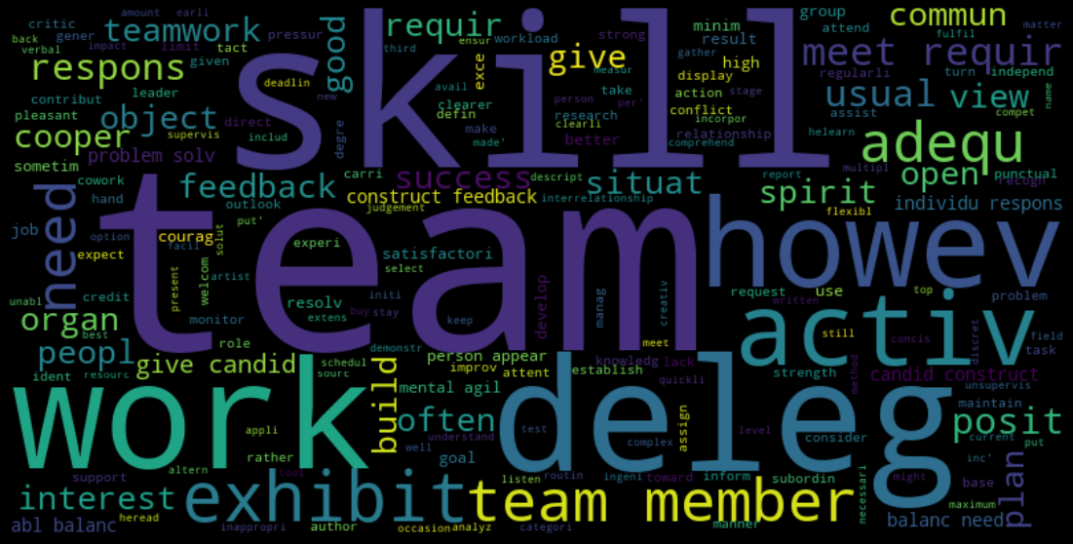
Good Review
Bad Review
Bag of words

Slide 15
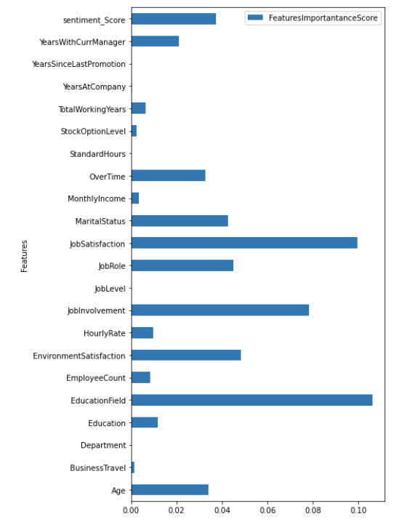
Feature Importances calculations
Top 3 Features with highest score:
JobSatisfaction,
JobInvolvement,
Education Field

Slide 16
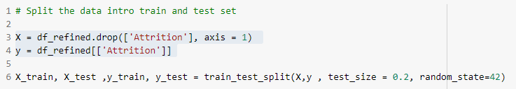
Training and Test Dataset
Split Dataset into two, one is for training and one is for validation
20% for the testing set and the remaining 80% will be the training set
Use train_test_spilt() from scikit-learn

Slide 17
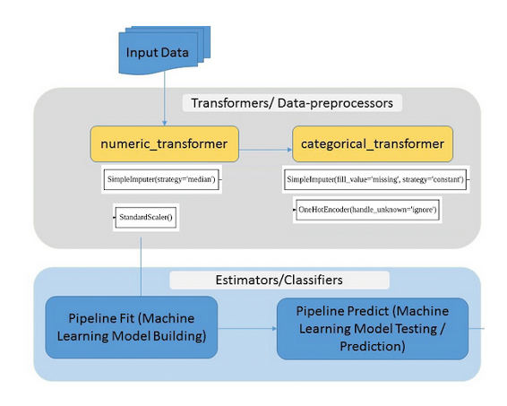
Pipeline workflow
Automatically identifies categorical and numeric columns/features.
Setup pipelines for categorical and numeric transformers.
We used ColumnTransformer to combine these transformation pipelines.

Slide 18
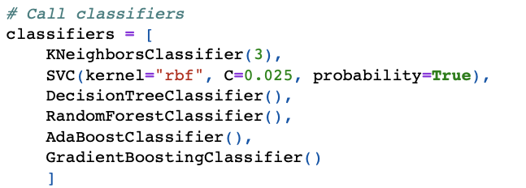
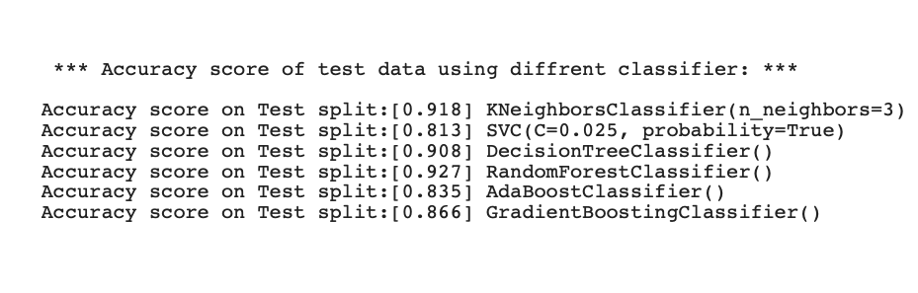
Model Selection - Accuracy Scores
We also used pipeline during the model selection process. Our code loops through a number of scikit-learn classifiers applying the transformations and training the model.
RandomForestClassifier
KNeighborsClassifier
DecisionTreeClassifier
GradientBoostingClassifier
AdaBoostClassifier
SVC
Notes:
The following Accuracy score of test data using following scikit-learn classifiers:
0.927 RandomForestClassifier()
0.918 KNeighborsClassifier
0.908 DecisionTreeClassifier()
0.866 GradientBoostingClassifier()
0.835 AdaBoostClassifier()
0.813 SVC

Slide 19

Thank you!
Any Questions?
Improvements/Next Steps
Enhance training programs
Appreciation to the employee (e-recognition card and rewards)
Provide a real time feedback (1-on-1 meeting)
Opportunities to advance
Google Drive Link GitHub

